Slide 1
RESUME ANALYSIS USING NLP MODELS
Under the guidance of
Dr. K. Upendra Chowdary M.Tech(Ph.D) Associate Professor in ECE
Presented by
K.Shasi Vardhan(Y22EC086)

Slide 2
Table of contents
Problem Statement
Objective
Abstract
Literature Survey
Existing System
Proposed System
NER module
ATS module
Results
References

Slide 3
Problem Statement
In today’s world, freshers face challenges in recruitment as they are often unaware of why they arenot suitable for a role. Manual resume screening is slow, inconsistent, and biased, leavingcandidates without proper feedback or guidance.
To overcome this, an AI-based system is proposed that uses NER, ATS, and RAG to extract details,assess job-fit, provide explanations, and generate mock interview questions. This makesrecruitment faster and fairer while helping freshers improve their resumes and interview readiness.

Slide 4
Objective
To study existing recruitment and resume screening methods and identify their limitations.
To develop an AI-based system for automated resume parsing & analysis unsing NLP models.
To extract structured data: name, skills, education, work experience.
To evaluate resumes using ATS-based techniques and to provide accuracy score for job suitability.
To provide actionable feedback to candidates and suggest improvements via RAG
based recommendations.
To generate targeted mock interview questions and answer videos for candidates to improve preparedness.

Slide 5
Abstract
Recruitment and resume parsing are often inconsistent, causing delays, errors, and difficulty in identifying suitable candidates.
Manual screening is time-consuming, biased, and lacks scalability; candidates often do not receive clear feedback on role suitability.
Proposed AI-based system automates resume evaluation using NER, ATS, and RAG to extract details, assess job-fit, provide explanations, and generate mock interview questions and answer videos.
Streamlines the recruitment process, enabling faster, fairer, and data-driven decision-making while offering actionable feedback to candidates.

Slide 6
Literature Survey
S.NO | Author(year) | Title | Methodology | Results
1. | Pratik G. Raut, Prof. Rajesh D. Wagh(2024) | Resume Analyzer and Recommender System Using Python | Built with Python, Pyresparser, MySQL, and Streamlit to parse, score, and rank resumes securely with cloud deployment and GDPR compliance. | Achieved automated resume parsing, scoring, and ranking with secure data handling and intuitive visualization, enabling recruiters to quickly identify top candidates.
2. | Arvind Kumar Sinha, Md Amir Khusru Akhtar, Mohit Kumar(2023) | Automated Resume Parsing and Job Domain Prediction using Machine Learning. | Used NLP preprocessing (text extraction, cleaning, tokenization, lemmatization), entity recognition (spaCy, regex), and machine learning (Random Forest) to parse resumes and predict job domains. | Achieved 92.08% accuracy and 0.92 F1-score, with strong precision and recall across IT, Healthcare, Engineering, Marketing, Finance, and Education domains.

Slide 7
S.NO | Author(year) | Title | Methodology | Result
3. | G. Krishna Lohith, K. Varshith Reddy, P. Mounisha Reddy(2025) | NLP-Based Resume Analysis, Skill Enhancement & Job Automation. | Used NLP and ML for resume parsing, skill gap detection, course recommendations, and job matching via cosine similarity. | Achieved effective resume analysis, personalized learning paths, AI-based career guidance, and integrated job search support.
4. | K. L. Abhishek, M. Niranjanamurthy(2 025) | Developing an Intelligent Resume Screening Tool With AI-Driven Analysis and Recommendation Features. | Built an AI-powered resume analyzer using Python with NLP libraries (Pyresparser, NLTK), Streamlit for interface, and MySQL for structured storage. The tool extracts key details, provides skill recommendations, feedback, and analytics for recruiters and applicants. | Achieved improved resume parsing, skill recommendations, personalized feedback, analytics, and higher accuracy (85%) compared to existing tools like Hloom (80%) and ZipRecruiter (78%).

Slide 8
Existing System
Recruitment largely depends on manual resume screening by recruiters.
Evaluations are time-consuming, inconsistent, and prone to human bias.
Existing ATS systems focus only on basic keyword matching, without understanding context orsemantic relevance.
Unstructured resume data (skills, projects, internships) is not fully utilized for evaluation.
Candidates, especially freshers, receive no detailed feedback or guidance on why they are notsuitable for roles.
Current systems do not provide mock interview support, explanations, or personalizedimprovement suggestions.

Slide 9
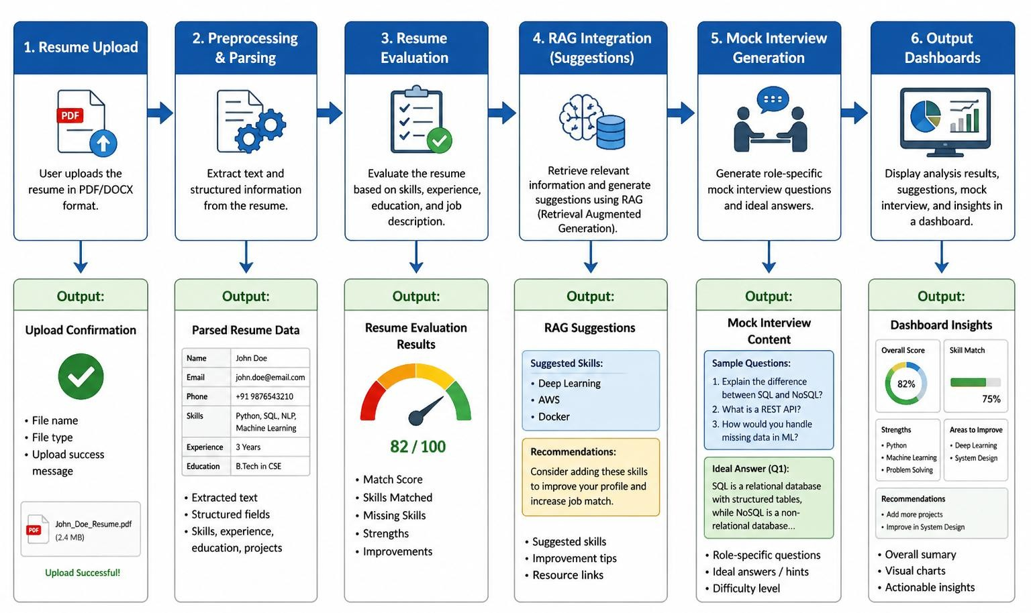
Proposed System
We propose a methodology to improve recruitment for freshers by automating resumeevaluation.The methodology includes:

Slide 10
NER MODULE
The NER module is used to extract important information from unstructured resume text.
It identifies key entities such as Name, Email, Phone Number, Education, Skills, and Experience.
The module uses Natural Language Processing (NLP) techniques to automatically understand resume content.
Extracted entities are converted into structured data for further processing.
This improves accuracy and reduces manual resume screening effort.
The output of the NER module is used as input for ATS scoring and job matching.

Slide 11
ATS MODULE
The ATS module evaluates how well a resume matches a given job description.
It compares keywords, skills, experience, and job requirements.
The module uses text similarity techniques to calculate relevance.
Each resume section is given a weighted score (skills, experience, education, projects).
A final ATS match score (percentage) is generated.
Higher ATS score indicates better suitability for the job role.

Slide 12
RAG Module Algorithm
RAG (Retrieval-Augmented Generation) combines retrieval and AI generation.
Converts resume into embeddings (numerical form).
Retrieves relevant job descriptions or skill data.
Performs semantic matching (understands meaning, not just keywords).
Compares skills, experience, and education with job requirements.
Generates match score, candidate summary, and skill gap analysis.
Reduces bias compared to traditional ATS.
Improves accuracy and efficiency in screening.
Helps identify relevant and hidden candidates.
Provides explainable results.

Slide 13
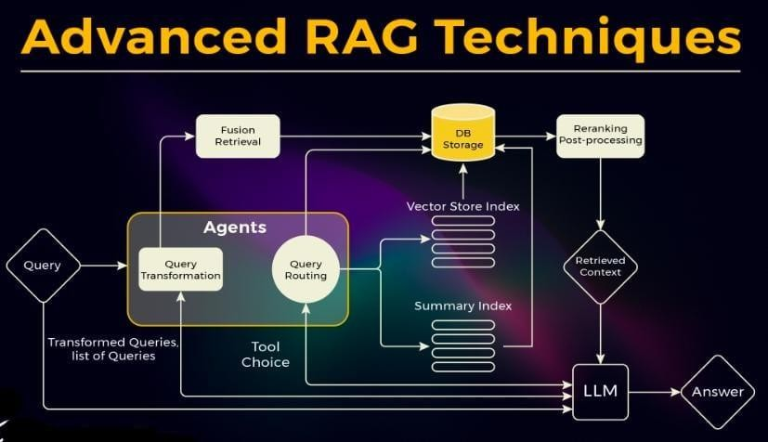
RAG Model

Slide 14
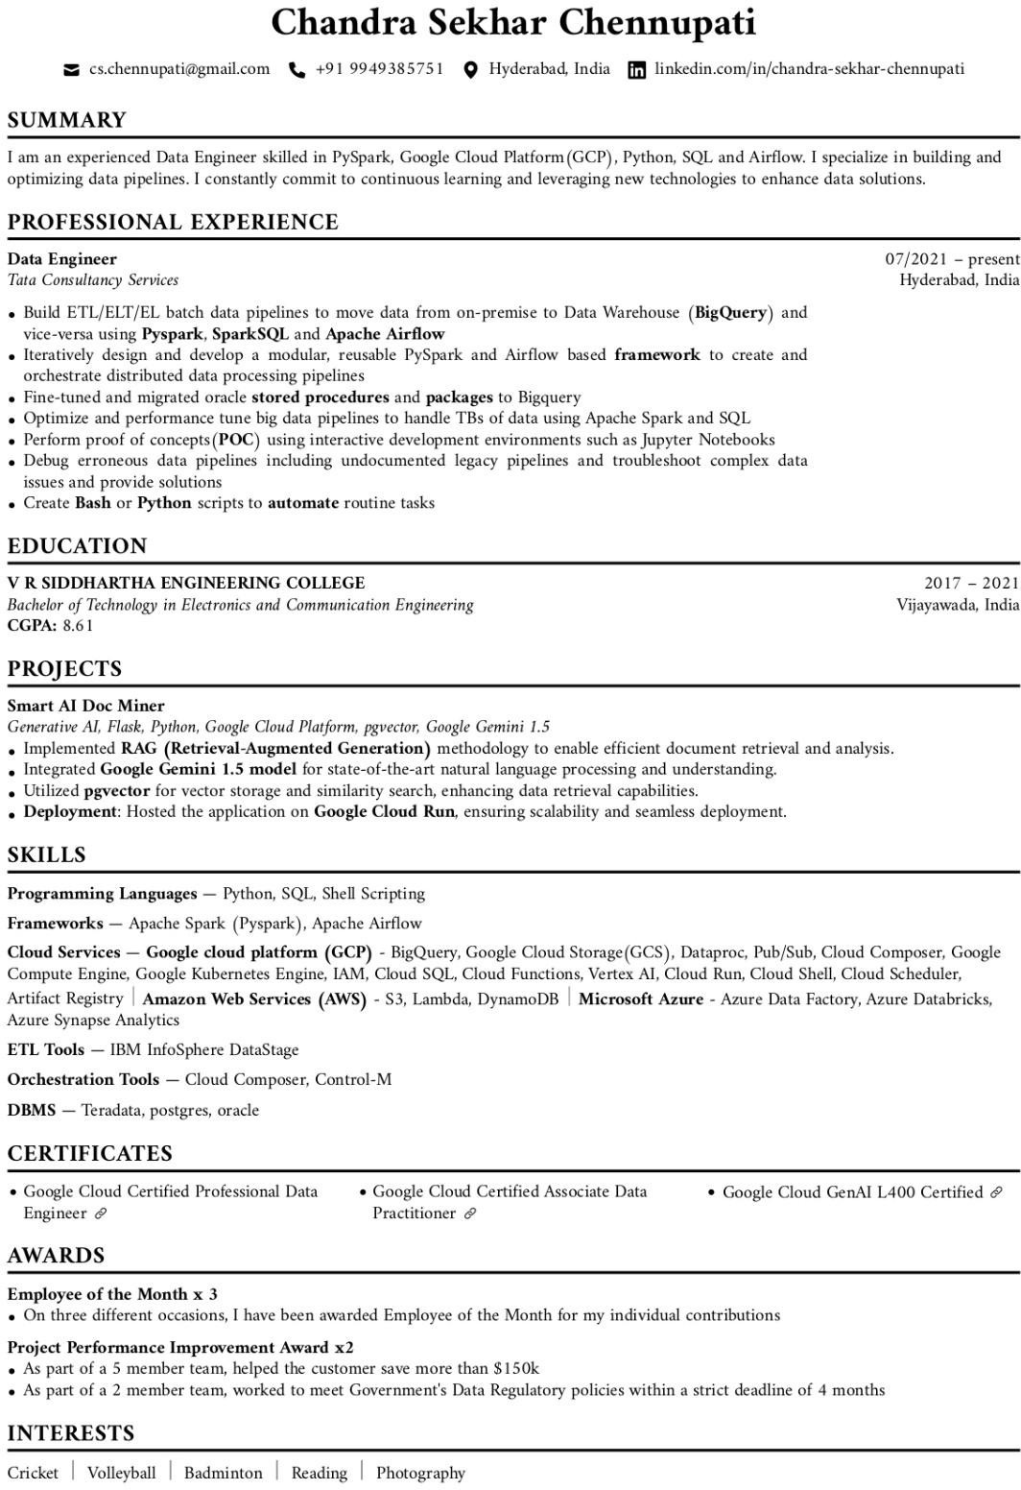
Results

Slide 15
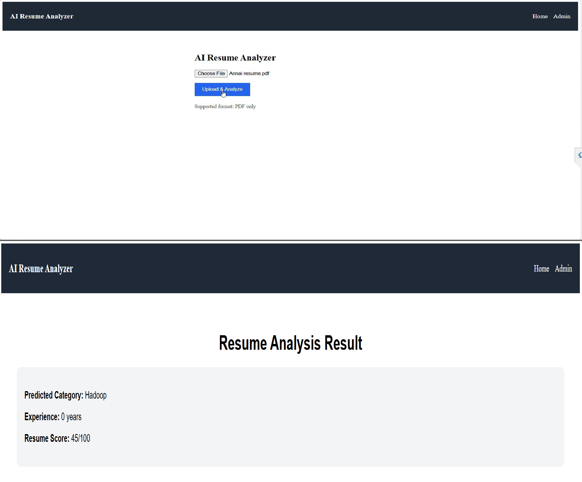

Slide 16
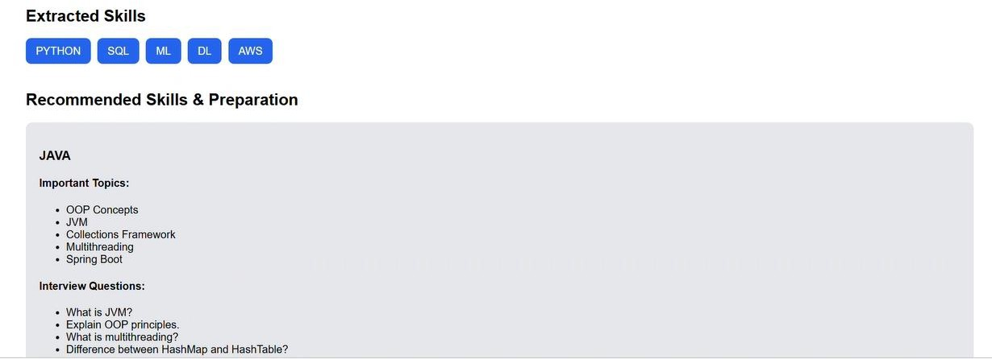
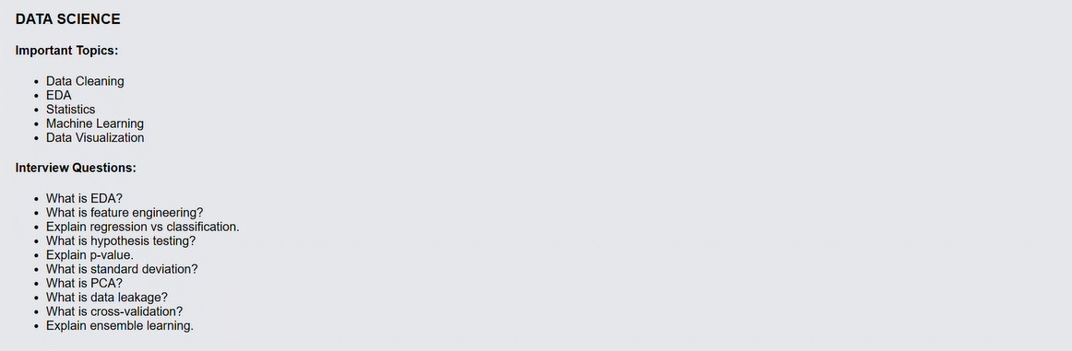

Slide 17
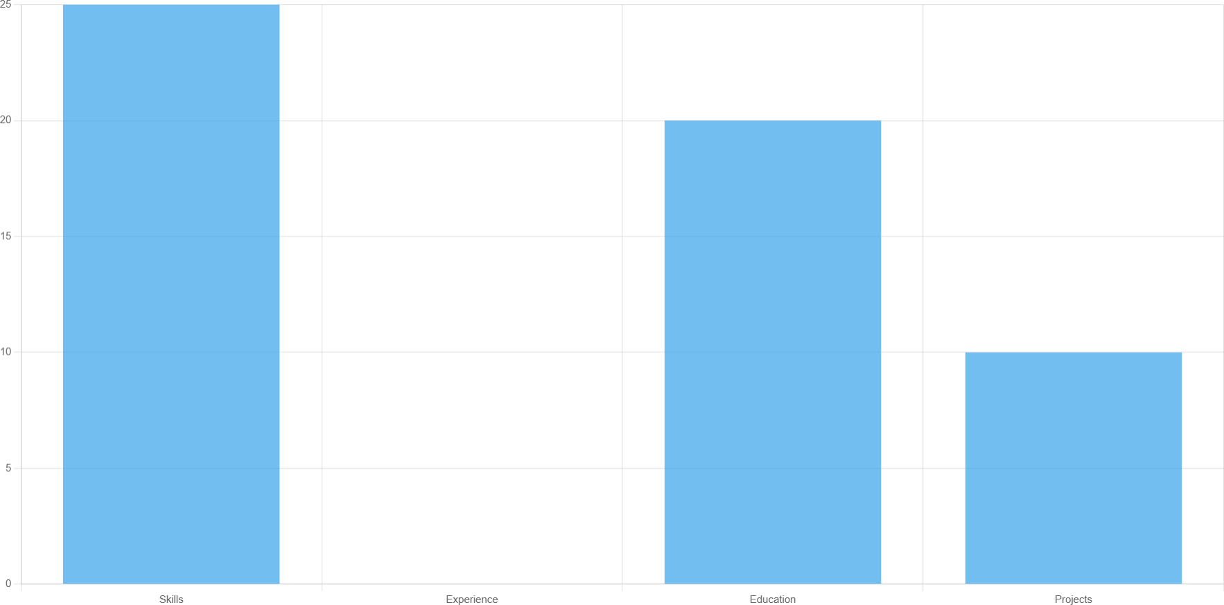
Scoring Graph1

Slide 18
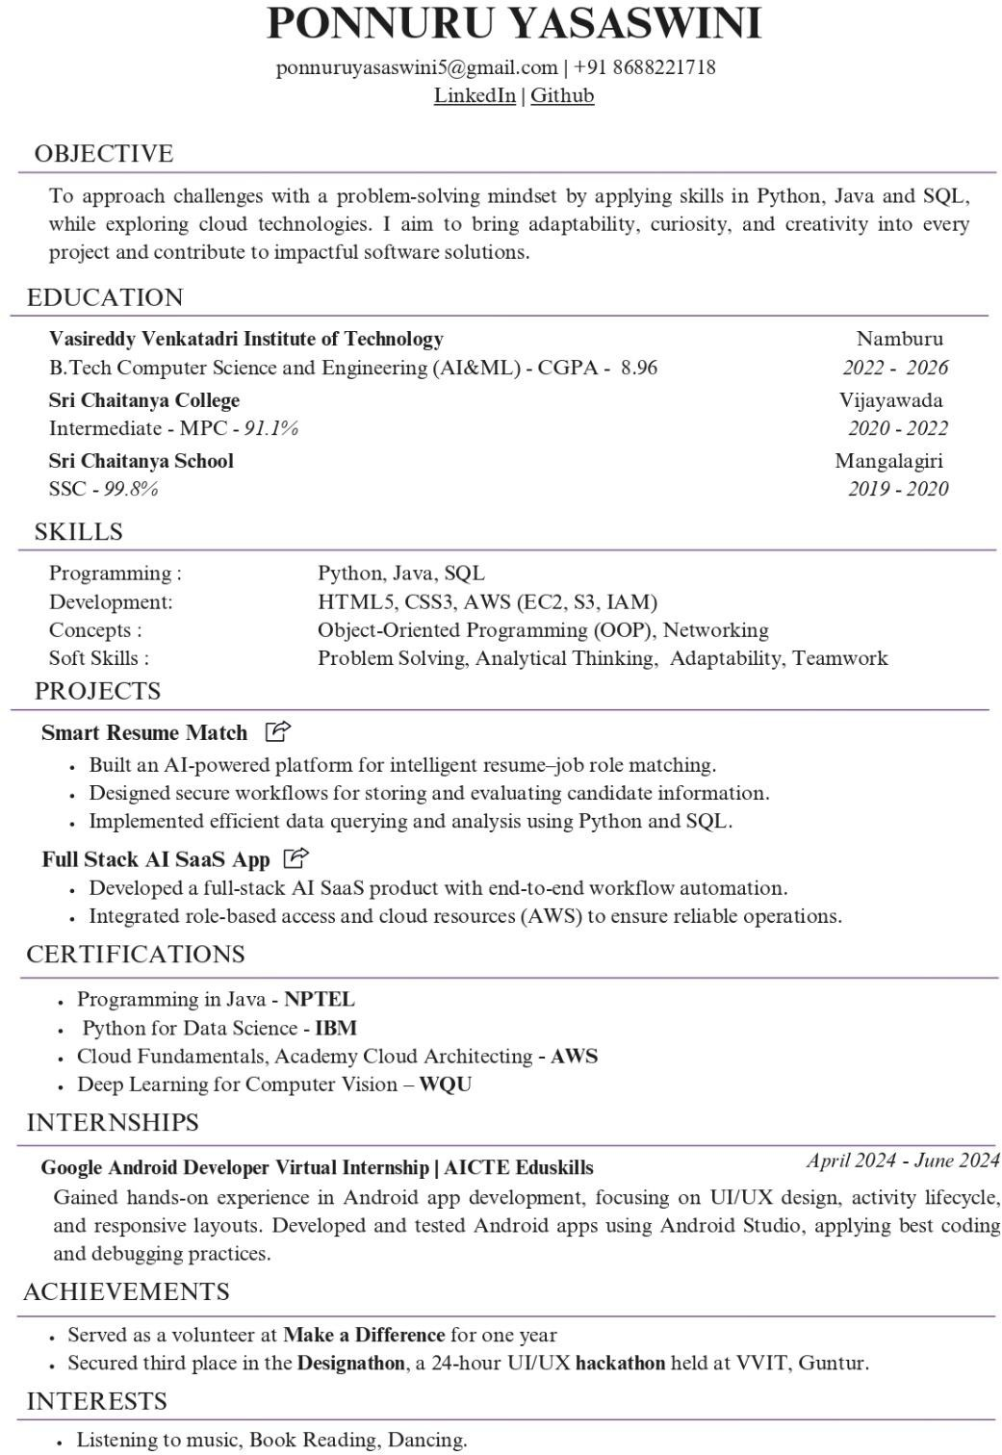

Slide 19
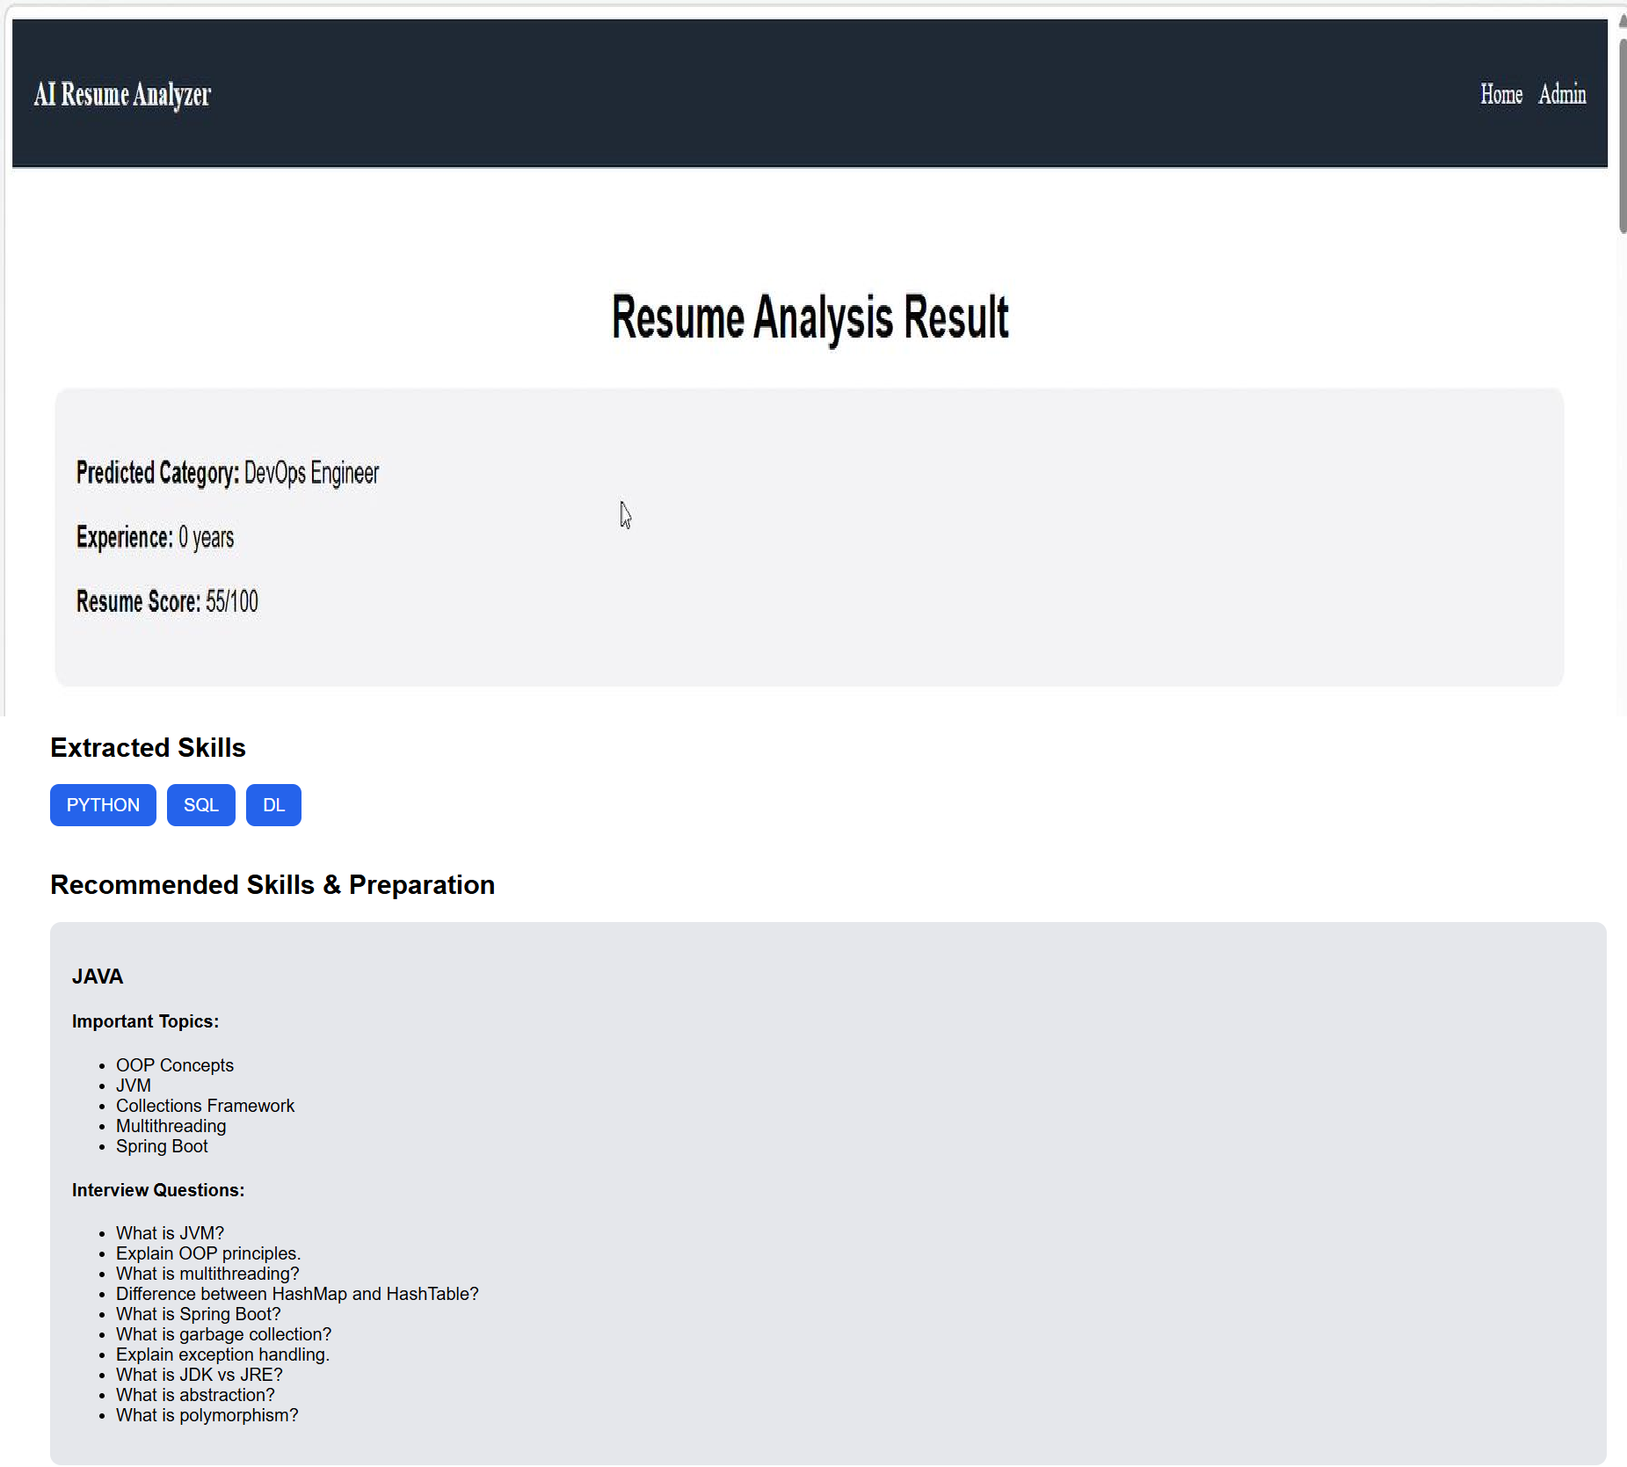

Slide 20
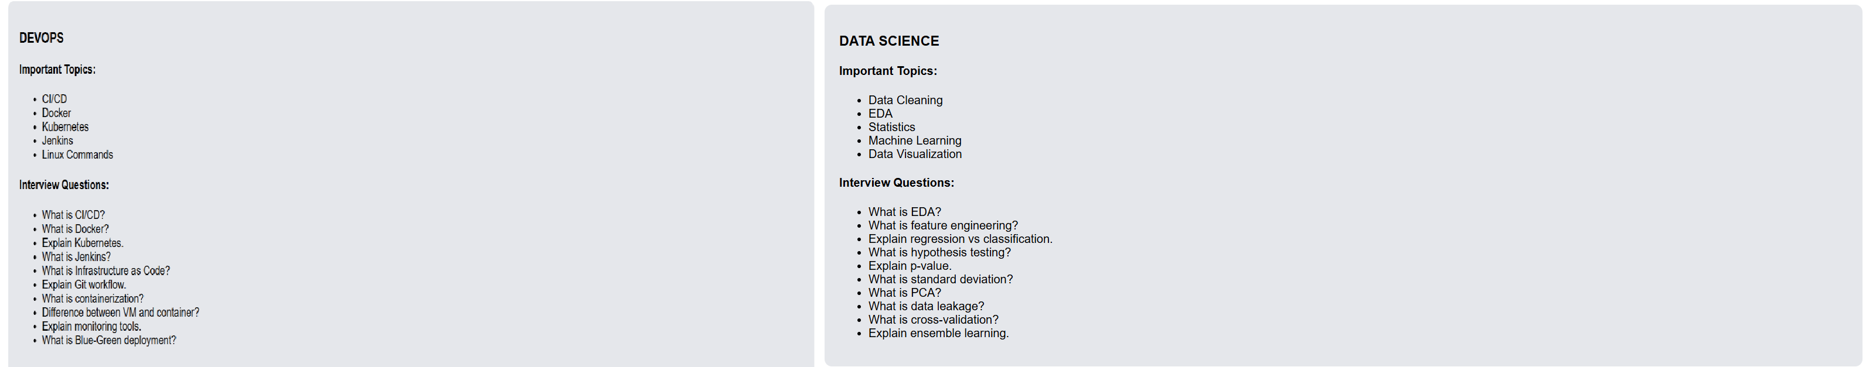

Slide 21
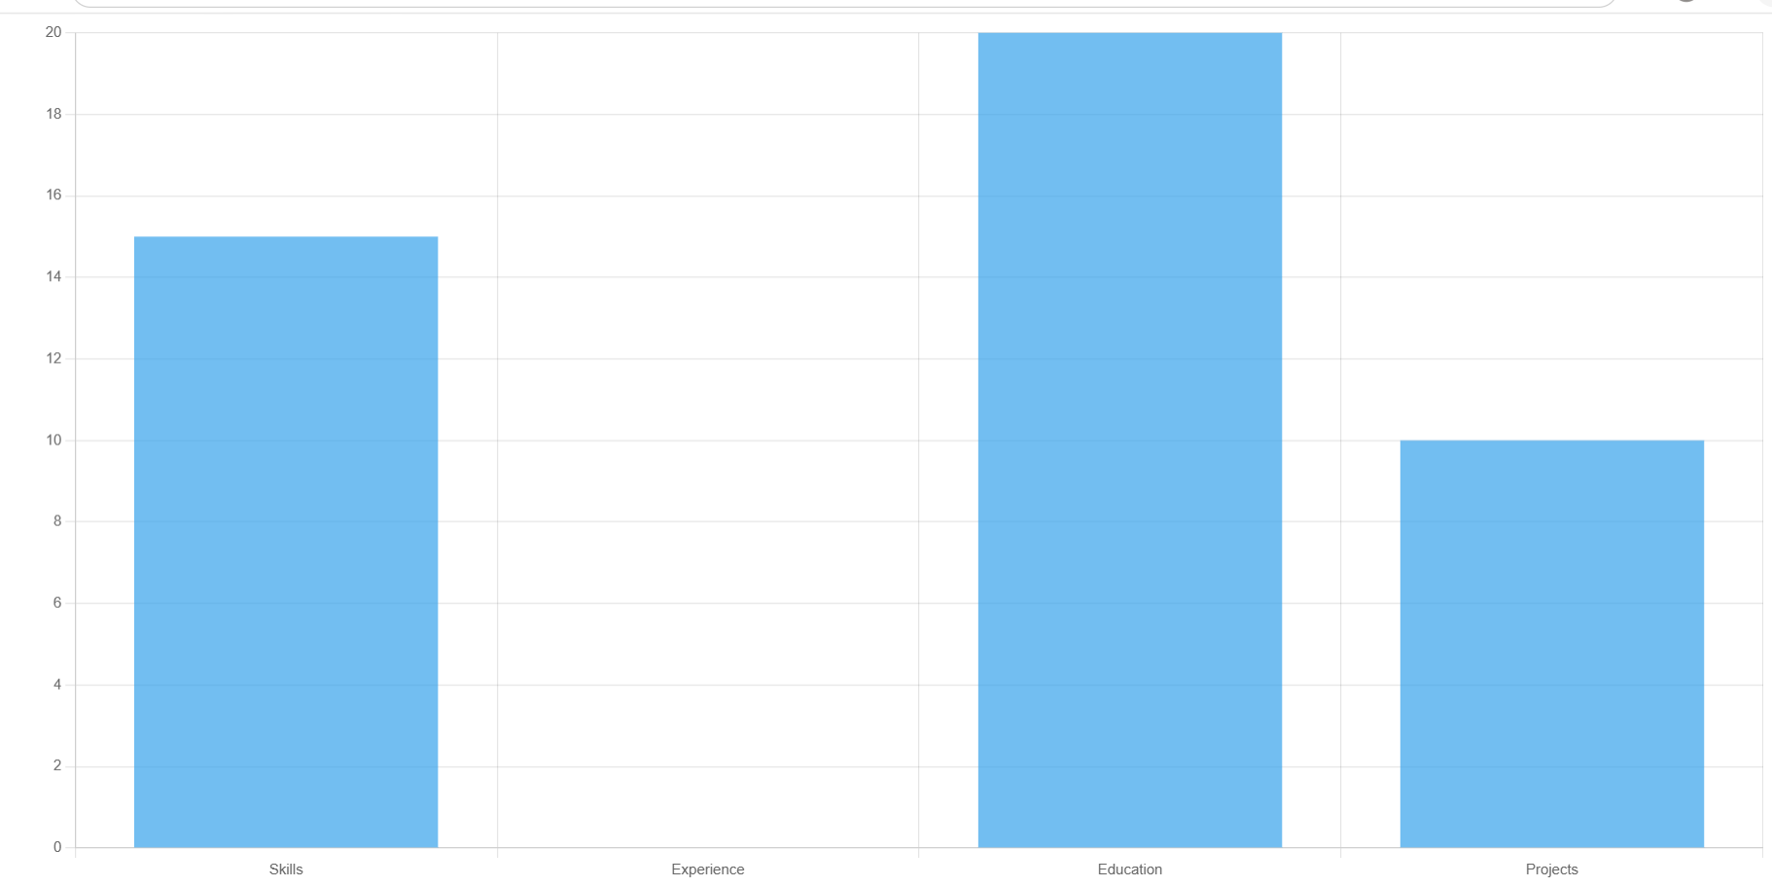
Scoring Graph2

Slide 22
References
J. Chen, C. Zhang, and Z. Niu, “A Two- Step Resume Information Extraction Algorithm 1–10,” (2018).
A. Kumar and R. Singh, “AI Based Skill Extraction from Resumes for Career Path Recommendation,” International Journal of Computer Applications, vol. 185, no. 7, pp. 25 31, 2023.
"Hands-On Machine Learning with Scikit-Learn, Keras, and TensorFlow: Concepts,
Tools, and Techniques to Build Intelligent Systems" by Aurélien Géron .
ChaudhariY,JadhavP,GuptaY. AnEndtoEndSolutionForAutomatedHiring. 2022FourthInternationalConferenceonEmergingResearchinElectronics, Computer Science and Technology (ICERECT),2022.

Slide 23
THANK YOU

